Slide 1
Bangla Text Summarizer
With Machine Learning + NLP
BANGLA
TEXT SUMMARIZER.
CSE 498R.30
Page | 01

Slide 2
Bangla Text Summarizer
TABLE
OF CONTENT.
1
Project Title with Authors’ List | 03
5
Tech stack | 07
2
Problem Statement | 04
6
Game Plan | 08
3
Existing Solutions with Pros & Cons | 05
7
6 Months Roadmap | 09
4
Related Projects & Unique Contributions | 06
8
Thank You | 10
Page | 02

Slide 3




Bangla Text Summarizer
PROJECT TITLE
BANGLA TEXT SUMMARIZER: MACHINE LEARNING AND NLP.
Md. Tanjeelur Rahman Labib
Tashin Mahmud Khan
Md. Tasin Hossain Toha
Md. Saikot Hossain Sojib
201 3677 642
201 1819 042
201 1664 042
201 4055 642
Page | 03

Slide 4

Bangla Text Summarizer
PROBLEM STATEMENT.
The proliferation of Bangla news portals presents a challenge in navigating so many articles within a limited time, compounded by the language's inherent complexity.
Overwhelming volume of Bengali news content online.
Limited time for comprehensive reading.
The inherent complexity of the Bengali language.
Difficulty in quickly grasping essential information from articles.
34
20 Mi
Verified Online Portal
Online News Reader
Page | 04

Slide 5

NEXT SPEAKER:
TASHIN.

Slide 6








Bangla Text Summarizer
EXISTING SOLUTIONS.
Macquarie University,
Sydney, Australia
+
+
+
+
Gujarat Technological University, Gujrat, India
Text summarization using unsupervised deep learning
Applying regression models to query-focused multi-document summarization
Query-oriented unsupervised multi-document summarization via deep learning model
Machine Learning Approach for Automatic Text Summarization Using Neural Networks
Pros:
No labeled data required for training.
Performs well compared to other techniques.
Cons:
Can be computationally expensive.
Pros:
Handles multi-document summarization effectively.
Combines supervised and unsupervised techniques.
Cons:
Focuses on sentence extraction (extractive summarization).
May require domain-specific adaptations.
Pros:
Investigates theory in educational administration.
Sociology of science lens provides insights.
Cons:
Highly conceptual, less focus on implementation.
May be dense for non-specialists.
Pros:
Proposes a novel summarization method using BERT (a powerful language model).
Potentially efficient through a clustering pre-processing step.
Cons:
Lack of clear evaluation metrics.
May be limited to extractive summarization techniques.
2
20th Oct, 2016
ScienceDirect
4
3rd April, 2010
ScienceDirect
4
15th June, 2015
ScienceDirect
4
2nd January, 2018
IJARCCE
Page | 05

Slide 7




#FE23C3,#C21BB6,#8713AA,#4B0A9D,#0F0290,#FE23C3,#C21BB6,#8713AA
Bangla Text Summarizer
RELATED PROJECTS & CONTRIBUTIONS.
Bangla Text Summarization using Deep Learning
Automated Bangla Text Summarization by Sentence Scoring and Ranking
Islamic University of Technology (IUT)
University of Dhaka
PDF
PDF
A Rule Based Extractive Text Summarization Technique for Bangla News Documents
Construction of an Automatic Bengali Text Summarizer Using Machine Learning Approaches
University of Dhaka
Feni University & United International University
PDF
PDF
Page | 06

Slide 8

NEXT SPEAKER:
TOHA.

Slide 9



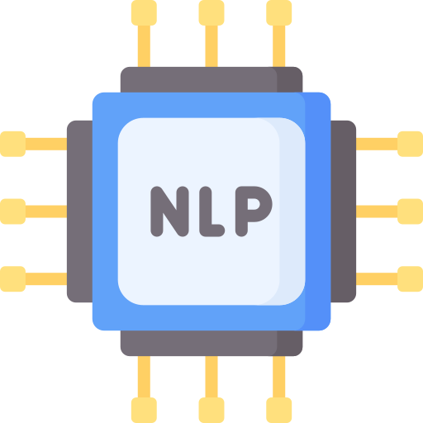



Bangla Text Summarizer
TECH STACK.
Machine Learning Frameworks (Scikit-learn, TensorFlow/Keras or PyTorch)
Python
NLP Libraries (NLTK, spaCy)
Data Reprocessing Libraries (Pandas, Re)
Streamlit (for UI)
Google Collab
Page | 07

Slide 10
Bangla Text Summarizer
Work Breakdown
Game Plan
.01
Task allocation leverages individual strengths for efficiency and quality.
Work Distribution, Plan & Cost.
Project Timeline
We’re breaking the project in to 4 main stages. Each stage work will be equally divided amongst the 4 member of the team. The below phases of work will be maintained through the next 6 months at least.
.02
6 - 8 month timeline incorporates flexible milestones to ensure project progress.
1
2
Budget Overview
.03
DATA FUNDAMENTALS
MODEL DEVELOPMENT
Cost-effective approach prioritizes open-source tools and Google Collab subscription.
3
4
EVALUATION & REFINMENT
INTEGRATION & DELIVERY
Page | 08

Slide 11

NEXT SPEAKER:
LABIB.

Slide 12
Bangla Text Summarizer
PROJECT TIMELINE: 6 MONTHS ROADMAP
Phases (P) / Milestones (M)
Month 1
Month 2
Month 3
Month 4
Month 5
Month 6
P1: Data Fundamentals
M1: Dataset Establishment
M2: Preprocessing & Exploration
P2: Model Development
M3: Baseline & Research
M4: Model Training & Refinement
P3: Evaluation & Refinement
M5: Metrics & Tracking
M6: Optimization & Analysis
P4: Integration & Delivery
M7: UI Development
M8: Deployment & Documentation
Page | 09

Slide 13

Bangla Text Summarizer
THANK YOU
AI is a tool. The choice about how it gets deployed is ours.
Page | 10

